Slide 1
Online News Popularity
Group 08
Amarendar Alwala
Amitesh Eti
Kalluri Siva Kumar Reddy
Vigneshwaran Kannan
Yumin Dong

Slide 2
Overview
Project : Popularity of online news
Goal : To analyze and identify a model to predict the popularity of an article published online (mashable.com)
Data Type : Second Hand Dataset
Data Repository :
UCI Machine Learning repository website

Slide 3
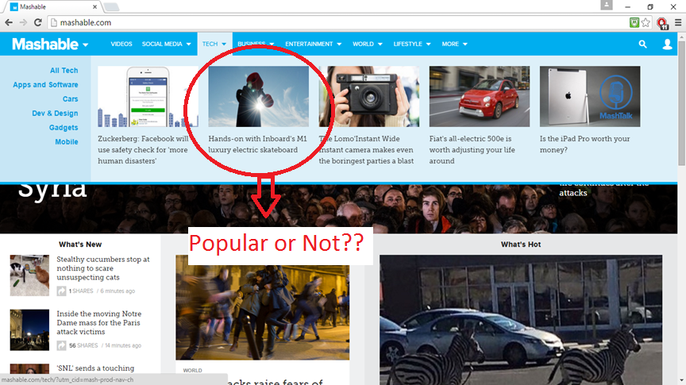
Mashable.com

Slide 4
Data Description
The dataset encapsulates a varied set of features about articles published by Mashable (www.mashable.com) over a period of two years.
This multivariate dataset has 39644 instances and covers 61 attributes, including 58 predictive attributes, 2 non predictive and 1 goal (Target) field. The two non-predictive attributes (URL and time delta) of the dataset do not affect the outcomes of analysis

Slide 5
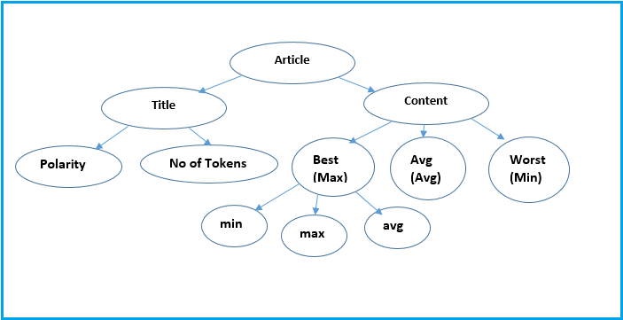
Attribute description

Slide 6
”India tops the list for censoring Facebook”
According to the data released by Facebook in its biannual Government Requests Report, India made 15,155 demands. In comparison, India had made 5,832 requests for content removal between June and December 2014.
The company stated that the posts were censored to prevent religious unrest in the country and had mostly been reported by government agencies. “We restricted access in India to content reported primarily by law enforcement agencies and the India Computer Emergency Response Team within the Ministry of Communications and Information Technology because it was anti-religious and hate speech that could cause unrest and disharmony within India,” the report stated.
India has topped the social network’s content removal list for the third year in running, since it began releasing the data in 2013. The country is also Facebook’s second-largest market in the world after US, with over 130 million users.

Slide 7
”India tops the list for censoring Facebook”
According to the data released by Facebook in its biannual Government Requests Report, India made 15,155 demands. In comparison, India had made 5,832 requests for content removal between June and December 2014.
The company stated that the posts were censored to prevent religious unrest in the country and had mostly been reported by government agencies. “We restricted access in India to content reported primarily by law enforcement agencies and the India Computer Emergency Response Team within the Ministry of Communications and Information Technology because it was anti-religious and hate speech that could cause unrest and disharmony within India,” the report stated.
India has topped the social network’s content removal list for the third year in running, since it began releasing the data in 2013. The country is also Facebook’s second-largest market in the world after US, with over 130 million users.

Slide 8
Other Potential Attributes
is_weekend
num_imgs
num_videos
num_hrefs
num_self_hrefs

Slide 9
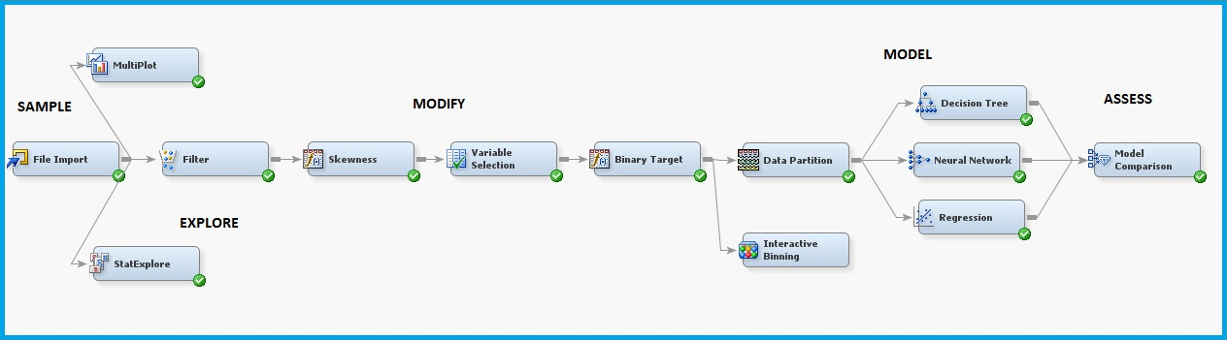
Project Diagram
In our predictive analysis we use SEMMA steps of SAS EM i.e. Sample, Explore, Modify, Model and Assess

Slide 10
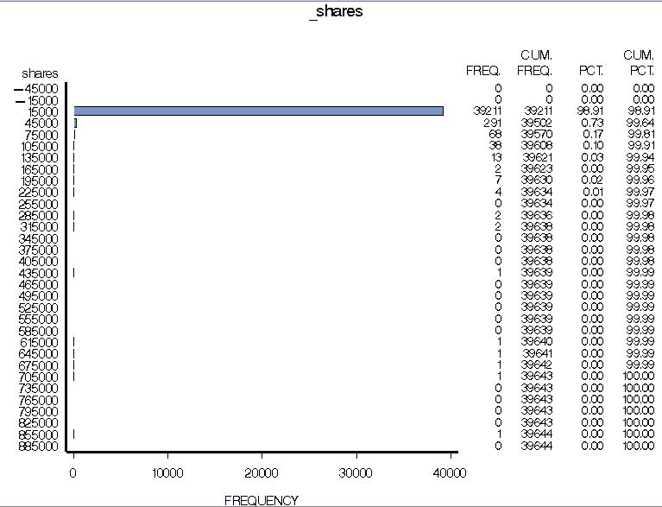
Explore
StatExplore: Identified the skewness of different variables
MultiPlot: Identified the frequency of target variable (_shares)

Slide 11
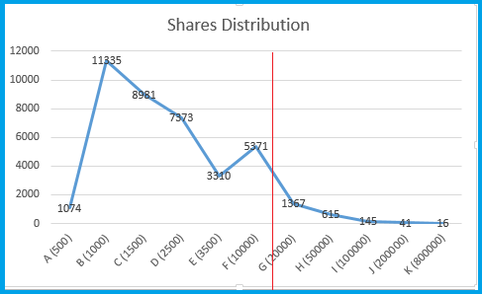
Filter Node
Share’s Range | Observations
< =15000 | 38380
> 15000 | 1264

Slide 12
Removing Skewness
Using Transform variable node - The variables with skewness greater than absolute value of 1 have been transformed with Log transformation.
The skewness of target variable is also reduced

Slide 13
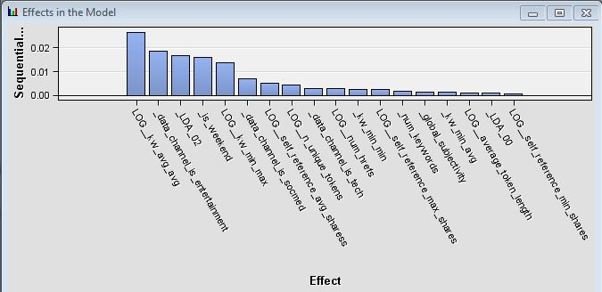
Variable Selection
Top 18 variables are selected which contribute most in predicting the target variable.

Slide 14
Transformation of Target Variable
In the Transform variables node, the target variable which was interval type, is converted to binary using formulas.
Formula: LOG_shares >= 7.24
Using the Interactive binning node, two equal target variable bins are created with 7.24 cut-off.

Slide 15
Data Partition
The data set is divided into 60% for training, 20% for validation and 20% for test data
Type | No. of Observations
Train (60%) | 23028
Validate (20%) | 7676
Test (20%) | 7676

Slide 16
Model
Following four models have been used for predictive analysis:
Decision Tree
Regression
Neural Network

Slide 17
Decision Tree
Classification of observations is based on binary target variable.
For compactness and accuracy
Total of 5 leafs were obtained.
Maximum depth of the tree is 6.

Slide 18
Regression
The target variable in our dataset is converted to Binary, we tested the dataset using the Logistic Regression model.
The dataset was tested using all the three selection models in logit
Model type | Misclassification Rate
Forward Regression | 0.3532
Backward Regression | 0.3528
Stepwise Regression | 0.3531
None | 0.3530

Slide 19
Neural Network
Average Squared Error for validation data is 0.212
Misclassification Rate as 0.341202
Akaike’s Information Criterion for training data as 20038.08.
The number of estimated weights chosen is 79.
Network architecture used is Multilayer perceptron.

Slide 20
Model Comparison
Model type | Average Squared Error | Misclassification Rate
Neural Network | 0.2127 | 0.341202
Regression | 0.2196 | 0.35152
Decision Tree | 0.2249 | 0.356289
As per the Misclassification rate Neural network best suits the dataset

Slide 21
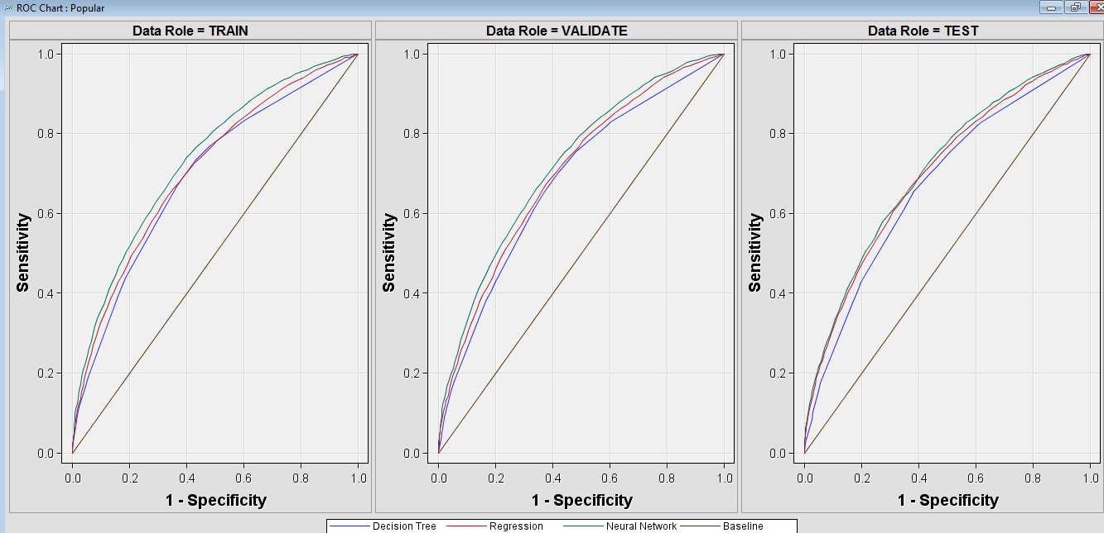
ROC Curve

Slide 22
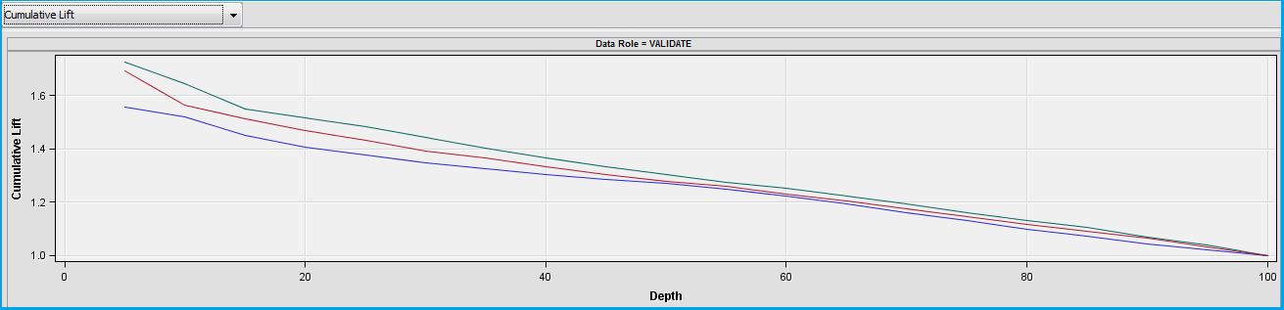
Cumulative Lift Chart

Slide 23
Confusion Matrix
Accuracy rate = 66.5%
Accuracy rate = 65.1%
Accuracy rate = 63.5%
Neural Network |  | Model Prediction
 |  | Non-popular | Popular
Actual | Non-Popular | 9072 | 4780
 | Popular | 5015 | 10373
Regression |  | Model Prediction
 |  | Non-popular | Popular
Actual | Non-Popular | 8791 | 4904
 | Popular | 5296 | 10249
Decision Tree |  | Model Prediction
 |  | Non-popular | Popular
Actual | Non-Popular | 8196 | 4370
 | Popular | 6521 | 10783

Slide 24
Business Value
Authors and content providers can use this report to modify articles before Publishing.
Website editors can also use this result to change the manner of its publication before it publishes.
Advertiser who needs a page in Mashable website to show their products or services.
Activists may consider publishing articles to expand influence of their opinions.

Slide 25
Questions & Answers

